Slide 1
Lagrangian description
r = r(ξ₁, ξ₂, ξ₃, t), … , ρ= ρ(ξ₁, ξ₂, ξ₃, t),
Time derivative
for material particle
(substantial time derivative)
Eulerian description
v = v(x₁, x_{2,}, x₃, t), ρ = ρ(x₁, x_{2,}, x₃, t),
v = v[t, x₁(ξ₁, ξ₂, ξ₃, t), x₂(ξ₁, ξ₂, ξ₃, t), x₃(ξ₁, ξ₂, ξ₃, t)].
ρ = ρ[t , x₁(ξ₁, ξ₂, ξ₃, t), x₂(ξ₁, ξ₂, ξ₃, t), x₃(ξ₁, ξ₂, ξ₃, t)],

Slide 2

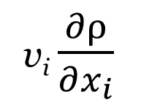
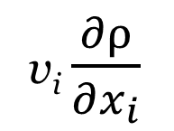
Time derivative for material particle (substantial time derivative)
for the Eulerian discription
∂ρ
$$\frac{dρ}{dt}≡\frac{∂ρ}{∂t}+v_{1}\frac{∂ρ}{∂x_{1}}+v_{2}\frac{∂ρ}{∂x_{2}}+v_{3}\frac{∂ρ}{∂x_{3}}=$$
≡ $\frac{∂ρ}{∂t}+$
≡ $\frac{∂ρ}{∂t}+$
3
Σ
v_{i} $\frac{∂ρ}{∂x_{i}}$
i = 1
v_{i} $\frac{∂ρ}{∂x_{i}}$

Slide 3
Mass conservation equation for Eulerian description
Material (substantial) derivative

Slide 4

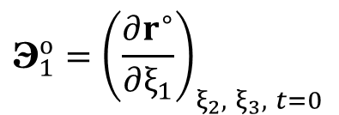


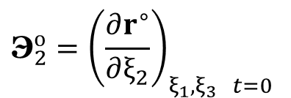

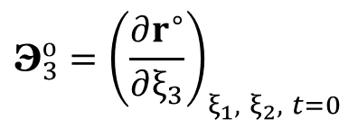


COMOVING COORDINATE SYSTEM (curvelinear)
x₃
ξ₂
r = x₁e₁ + x₂e₂ + x₃e₃
→
→
→
→
→
→
$${\text{Э}}_{2}^{о}$$
$${\text{Э}}_{3}^{о}$$
ξ₃
→
→
$${\text{Э}}_{1}^{о}$$
ξ₃
→
ξ₁
ξ₂
Inertial observer’s (resting and Cartesian)
r
→
→
w
→
→
ξ₁
e₃
→
→
Comoving
(curvilinear)
$\hat{r}$ = $\hat{r}$(ξ₁, ξ₂, ξ₃, t)
→
→
t = $\hat{t}$:
x₂
→
→
e₂
→
e₁
→
→
→
x₁
Comoving
(curvilinear)
→
→
$r^{∘}$= $r^{∘}$(ξ₁, ξ₂, ξ₃, t)
→
→
t = 0:
₃
∂ξ₃
₁
$${\text{Э}}_{1}^{о}={\left(\frac{∂r^{∘}}{∂​ξ_{1}}\right)}_{ξ_{2}, ξ_{3}, t=0}$$
$${\text{Э}}_{2}^{о}={\left(\frac{∂r^{∘}}{∂​ξ_{2}}\right)}_{ξ_{1},ξ_{3} t=0}$$
$${\text{Э}}_{3}^{о}={\left(\frac{∂r^{∘}}{∂​ξ_{3}}\right)}_{ξ_{1}, ξ_{2}, t=0}$$
→
→
→
→
→
→

Slide 5
Mass conservation equation for Eulerian description
Material (substantial) derivative

Slide 6
COMOVING COORDINATE SYSTEM (curvelinear)
x₃
ξ₂
r = x₁e₁ + x₂e₂ + x₃e₃
→
→
→
→
→
→
$${\text{Э}}_{2}^{о}$$
$${\text{Э}}_{3}^{о}$$
ξ₃
→
→
$${\text{Э}}_{1}^{о}$$
ξ₃
→
ξ₁
ξ₂
Inertial observer’s (resting and Cartesian)
r
→
→
w
→
→
ξ₁
e₃
→
→
Comoving
(curvilinear)
$\hat{r}$ = $\hat{r}$(ξ₁, ξ₂, ξ₃, t)
→
→
t = $\hat{t}$:
x₂
→
→
e₂
→
e₁
→
→
→
x₁
Comoving
(curvilinear)
→
→
$r^{∘}$= $r^{∘}$(ξ₁, ξ₂, ξ₃, t)
→
→
t = 0:
₃
∂ξ₃
₁
$${\text{Э}}_{1}^{о}={\left(\frac{∂r^{∘}}{∂​ξ_{1}}\right)}_{ξ_{2}, ξ_{3}, t=0}$$
$${\text{Э}}_{2}^{о}={\left(\frac{∂r^{∘}}{∂​ξ_{2}}\right)}_{ξ_{1},ξ_{3} t=0}$$
$${\text{Э}}_{3}^{о}={\left(\frac{∂r^{∘}}{∂​ξ_{3}}\right)}_{ξ_{1}, ξ_{2}, t=0}$$
→
→
→
→
→
→

Slide 7
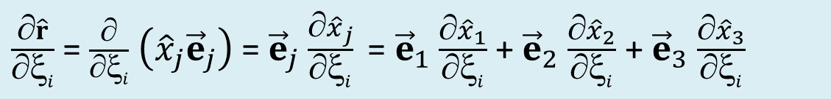
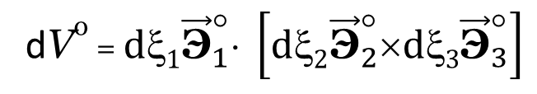
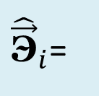

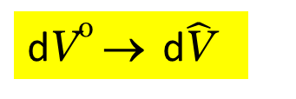
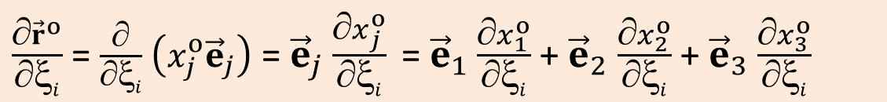
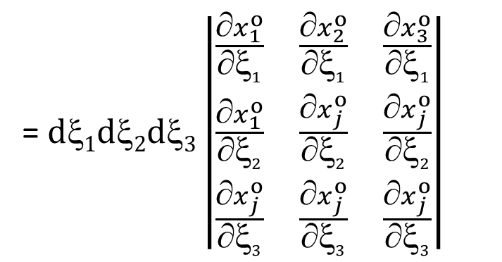
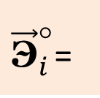
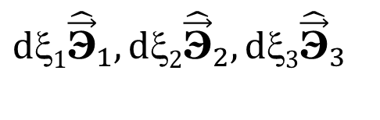
Mass conservation equation for Lagrangian description
→
$${dξ1\vec{\text{Э}}}_{1}^{°},dξ2{\vec{\text{Э}}}_{2}^{°},dξ3{\vec{\text{Э}}}_{3}^{°}$$
→
$$dξ1{\hat{\vec{\text{Э}}}}_{1},dξ2{\hat{\vec{\text{Э}}}}_{2},dξ3{\hat{\vec{\text{Э}}}}_{3}$$
Paralepidid
Paralepiped
dVº → d$\hat{\text{V}}$
${\vec{\text{Э}}}_{i}^{°}$=
$\frac{∂{\vec{r}}^{o}}{∂ξi}$ = $\frac{∂}{∂ξi}$ $\left(x_{j}^{o}{\vec{e}}_{j}\right)$ = ${\vec{e}}_{j}$ $\frac{∂x_{j}^{o}}{∂ξi}$ = ${\vec{e}}_{1}$ $\frac{∂x_{1}^{o}}{∂ξi}$ + ${\vec{e}}_{2}$ $\frac{∂x_{2}^{o}}{∂ξi}$ + ${\vec{e}}_{3}$ $\frac{∂x_{3}^{o}}{∂ξi}$
${\hat{\vec{\text{Э}}}}_{i}$=
$\frac{∂\hat{r}}{∂ξi}$ = $\frac{∂}{∂ξi}$ $\left({\hat{x}}_{j}{\vec{e}}_{j}\right)$ = ${\vec{e}}_{j}$ $\frac{∂{\hat{x}}_{j}}{∂ξi}$ = ${\vec{e}}_{1}$ $\frac{∂{\hat{x}}_{1}}{∂ξi}$ + ${\vec{e}}_{2}$ $\frac{∂{\hat{x}}_{2}}{∂ξi}$ + ${\vec{e}}_{3}$ $\frac{∂{\hat{x}}_{3}}{∂ξi}$
= $d1d2d3\left|\begin{matrix}\frac{x_{1}^{o}}{1} & \frac{x_{2}^{o}}{1} & \frac{x_{3}^{o}}{1} \\ \frac{x_{1}^{o}}{2} & \frac{x_{j}^{o}}{2} & \frac{x_{j}^{o}}{2} \\ \frac{x_{j}^{o}}{3} & \frac{x_{j}^{o}}{3} & \frac{x_{j}^{o}}{3}\end{matrix}\right|$
Scalar triple product
of these vectors
dVº = ${dξ1\vec{\text{Э}}}_{1}^{°}⋅ \left[dξ2{\vec{\text{Э}}}_{2}^{°}×dξ3{\vec{\text{Э}}}_{3}^{°}\right]$

Slide 8
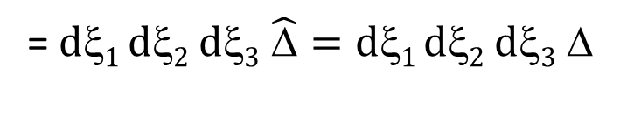
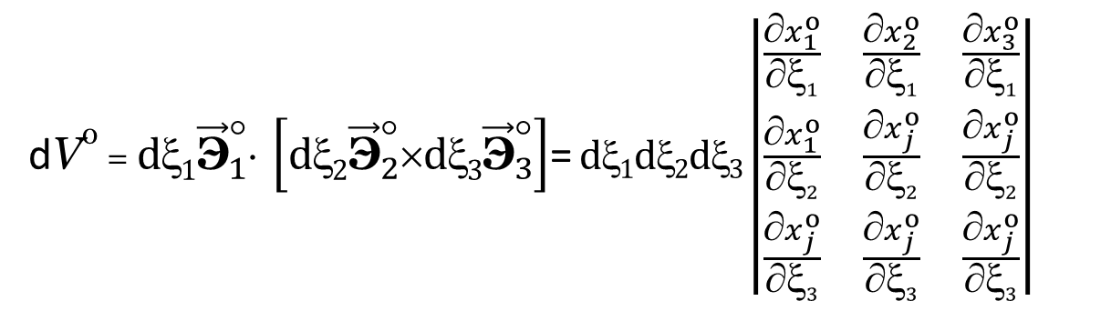
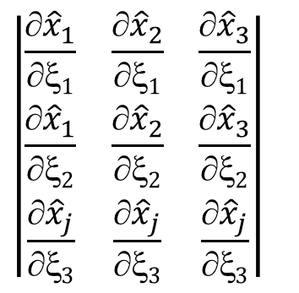
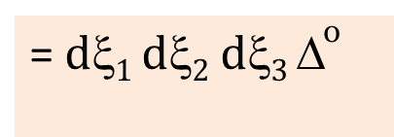
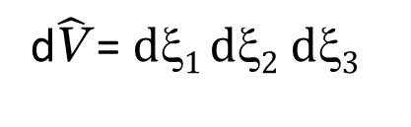
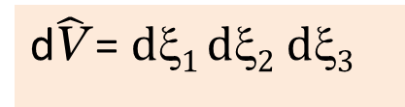
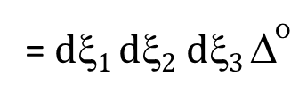
dVº = ${dξ1\vec{\text{Э}}}_{1}^{°}⋅ \left[dξ2{\vec{\text{Э}}}_{2}^{°}×dξ3{\vec{\text{Э}}}_{3}^{°}\right]$= $d1d2d3\left|\begin{matrix}\frac{x_{1}^{o}}{1} & \frac{x_{2}^{o}}{1} & \frac{x_{3}^{o}}{1} \\ \frac{x_{1}^{o}}{2} & \frac{x_{j}^{o}}{2} & \frac{x_{j}^{o}}{2} \\ \frac{x_{j}^{o}}{3} & \frac{x_{j}^{o}}{3} & \frac{x_{j}^{o}}{3}\end{matrix}\right|$
= $d1 d2$ $d3$Δº
= $d1 d2$ $d3$Δº
dVº =
$$\left|\begin{matrix}\frac{{\hat{x}}_{1}}{1} & \frac{{\hat{x}}_{2}}{1} & \frac{{\hat{x}}_{3}}{1} \\ \frac{{\hat{x}}_{1}}{2} & \frac{{\hat{x}}_{2}}{2} & \frac{{\hat{x}}_{3}}{2} \\ \frac{{\hat{x}}_{j}}{3} & \frac{{\hat{x}}_{j}}{3} & \frac{{\hat{x}}_{j}}{3}\end{matrix}\right|$$
d$\hat{\text{V}}$ = $d1 d2$ $d3$
= $d1 d2$ $d3$ $\hat{\text{Δ}}=dξ1 dξ2 dξ3$ Δ
Δ
d$\hat{\text{V}}$ = $d1 d2$ $d3$
Δ

Slide 9
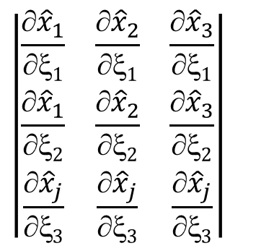
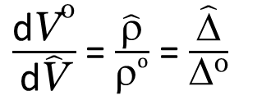
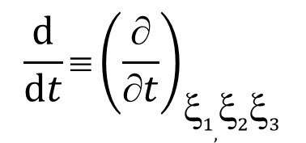
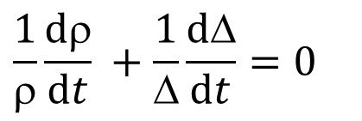
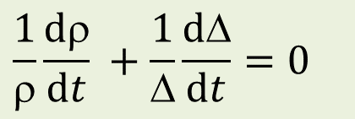
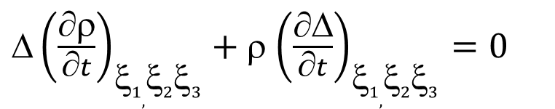
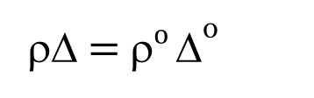
Mass conservation equation
$\frac{\text{d}\text{V}\text{o}}{\text{d}\hat{\text{V}}}$ = $\frac{\hat{\text{ρ}}}{\text{ρ}o}$ =$\frac{\hat{\text{Δ}}}{\text{Δ}\text{o}}$
ρV = ρº dVº
ρΔ$\text{= }\text{ρ}o$Δº
${\text{}\left(\frac{∂ρ}{∂t}\right)}_{ξ1,ξ2ξ3}+$ρ ${\left(\frac{∂\text{Δ}}{∂t}\right)}_{ξ1,ξ2ξ3}=0$
$$\frac{1}{ρ}\frac{dρ}{dt} +\frac{1}{\text{Δ}}\frac{d\text{Δ}}{dt}=0$$
Mass conservation equation
Lagrangian description
Eulerian description
$$\frac{1}{ρ}\frac{dρ}{dt} +\frac{1}{\text{Δ}}\frac{d\text{Δ}}{dt}=0$$
$$\left|\begin{matrix}\frac{{\hat{x}}_{1}}{1} & \frac{{\hat{x}}_{2}}{1} & \frac{{\hat{x}}_{3}}{1} \\ \frac{{\hat{x}}_{1}}{2} & \frac{{\hat{x}}_{2}}{2} & \frac{{\hat{x}}_{3}}{2} \\ \frac{{\hat{x}}_{j}}{3} & \frac{{\hat{x}}_{j}}{3} & \frac{{\hat{x}}_{j}}{3}\end{matrix}\right|$$
Δ =
$${\frac{d}{dt}≡\left(\frac{∂}{∂t}\right)}_{ξ1,ξ2ξ3}$$
Material (substantial) derivative

Slide 10
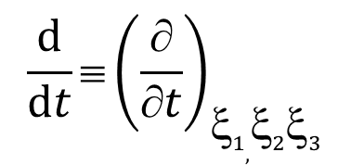
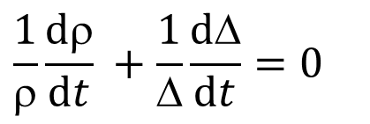
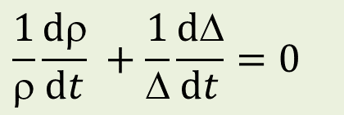
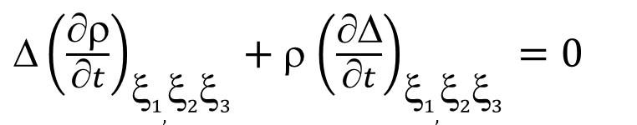
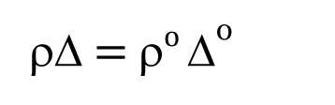
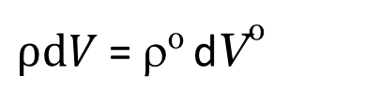
ρΔ$\text{= }\text{ρ}o$Δº
$\frac{\text{d}\text{V}\text{o}}{\text{d}\hat{\text{V}}}$ = $\frac{\hat{\text{ρ}}}{\text{ρ}o}$ =$\frac{\hat{\text{Δ}}}{\text{Δ}\text{o}}$
$ρdV$ = ρº dVº
${\text{}\left(\frac{∂ρ}{∂t}\right)}_{ξ1,ξ2ξ3}+$ρ ${\left(\frac{∂\text{Δ}}{∂t}\right)}_{ξ1,ξ2ξ3}=0$
$$\frac{1}{ρ}\frac{dρ}{dt} +\frac{1}{\text{Δ}}\frac{d\text{Δ}}{dt}=0$$
Mass conservation equation
Lagrangian description
Eulerian description
$$\frac{1}{ρ}\frac{dρ}{dt} +\frac{1}{\text{Δ}}\frac{d\text{Δ}}{dt}=0$$
$$\left|\begin{matrix}\frac{{\hat{x}}_{1}}{1} & \frac{{\hat{x}}_{2}}{1} & \frac{{\hat{x}}_{3}}{1} \\ \frac{{\hat{x}}_{1}}{2} & \frac{{\hat{x}}_{2}}{2} & \frac{{\hat{x}}_{3}}{2} \\ \frac{{\hat{x}}_{j}}{3} & \frac{{\hat{x}}_{j}}{3} & \frac{{\hat{x}}_{j}}{3}\end{matrix}\right|$$
Δ =
$${\frac{d}{dt}≡\left(\frac{∂}{∂t}\right)}_{ξ1,ξ2ξ3}$$
Material (substantial) derivative

Slide 11
CONTINUA MECHANICS
foundations of continuum dynamics:
forces and stresses

Slide 12
Forces and Force Fields in Continuum Mechanics
δm a(x, t) δm = ρ(x, t) dV
→
→
→
1. Body forces act throughout the volume dV of the particle in question.
2. Contact forces act on the boundary surface dS of the particle in question due to intermolecular interactions on distances δ < 10⁻⁹ m = 10 A
°
∼
Stable
Regular
Representative
→
→
→
→
→
→
→
F = g + R + a_{(inertia)} = g′ + R , (g′ = g + a_{(inertia)}
→
→
→
→
→
→
→
→
g - gravitational force
R - electromagnetic (ponderomotive) force
→
→
a_{(in)} - inertial force density equals to the negative acceleration of the (non-inertial)
frame of reference in which particle velocity v and acceleration a considered
→

Slide 13
Surface contact forces and traction vector
Contact forces (INTERNAL FORCES) arise from atomic-scale or intermolecular interactions and weaken over distances on the order of intermolecular separation
l_{mol} << dx << L
Compressibility,
Elasticity,
Viscosity,
Plasticity,
Material strength.

Slide 14
n is the outward unit normal to an infinitesimal (δr << L) surface of area dS
→
δP
→
δS
n
→
M
δr₂
→
δr₁
δr₁ ∼ δr₂∼ δr
∼ l_{microt}
Δ_{min}
Δ_{max}
∼ L
δr
→
→
→
depends on position of M, normal n, sizes and shape of δS
→
1. l_{micro}<< Δ_{min}< δr < Δ_{max}<< L − Plateau or Stability
→
→
→
Does not depend
on sizes and shape of δS

Slide 15
→
→
→
→
∼ l_{microt}
Δ_{min}
Δ_{max}
∼ L
δr
1. l_{micro}<< Δ_{min}< δr < Δ_{max}<< L − Plateau or Stability
σ
→
→
n
2. Regular
→
S
V
3. Representative
→
→
n
→
σ
→

Slide 16
→
→
→
→
a continuous field is an approximate model of contact forces that is applicable on scales far exceeding intermolecular separations and constituent particle sizes.
dP(n)
Newton's third law –
- action equals reaction
→
→
dS(n)
n
→
→
dP(n) = – dP(–n)
→
→
→
→
M
M
dS(–n)
–n
→
→
→
→
→
→
→
→
→
dP(–n)
→
Odd function of unit normal n.
→

Slide 17
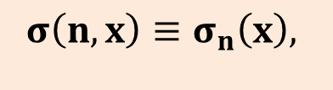
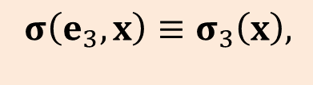
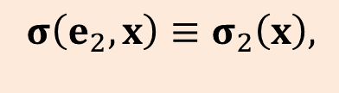

Stress Tensor
x₃
A₃
Arbitrary tetrahedron
σ(– e₁)
→
→
σ(– e₂)
n
– e₁
→
→
→
→
– e₂
σ(n)
→
→
→
x₂
M
A₂
→
→
→
→
→
→
A₁
– e₃
→
σ(– e₃)
x₁
→
→
→
→
→
→
(i =1, 2, 3).
→
→
→
→
→
→
(i =1, 2, 3).
$$σ\left(e_{1},x\right)≡σ_{1}\left(x\right),$$
$$σ\left(e_{2},x\right)≡σ_{2}\left(x\right),$$
$$σ\left(e_{3},x\right)≡σ_{3}\left(x\right),$$
$$σ\left(n,x\right)≡σ_{n}\left(x\right),$$
→
→
→
→
→
→
→
→
→
→
→
→
→
→
→
→
→
→
→
→

Slide 18

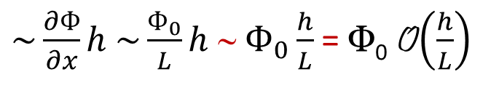
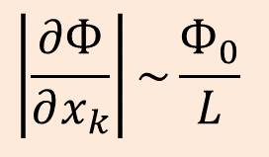
O(x)/x K
0 < K < ∞
O(x) Kx 0
$$\left|\frac{∂Ф}{∂x_{k}}\right|\sim \frac{Ф_{0}}{L}$$
x→0
Mean Value Theorem
x→0
x→0
$$\tilde{M}⊂V$$
o(x)/x → 0
${\sim \frac{∂Ф}{∂x}h \sim \frac{Ф_{0}}{L}h ∼ Ф}_{0}\frac{h}{L}$ = Ф₀ O$\left(\frac{h}{L}\right)$
∼ L
∼ Ф₀
h
x

Slide 19
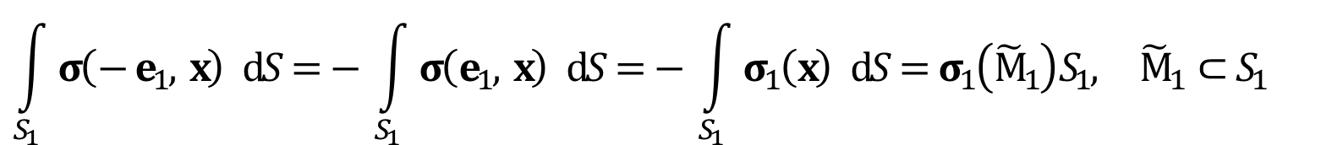
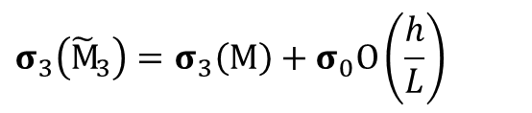
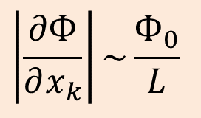
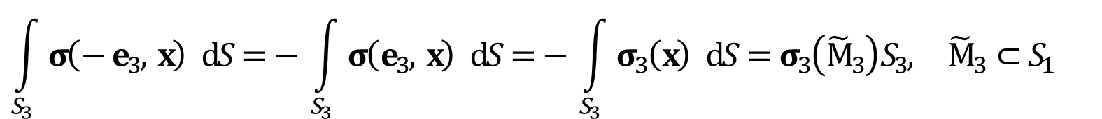
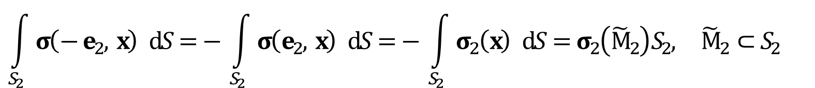
$σ\left(e_{i}, x\right)≡σ_{i}\left(x\right), σ\left(n, x\right)≡σ_{n}\left(x\right)$ (i = 1, 2, 3)
Newton’s second law
Ф ≡ ρ(F – a)
$$\left|\frac{∂Ф}{∂x_{k}}\right|\sim \frac{Ф_{0}}{L}$$
Mean Value Theorem
$$\int_{S_{1}}{σ\left(− e_{1}, x\right)} dS=− \int_{S_{1}}{σ\left(e_{1}, x\right)} dS=− \int_{S_{1}}{σ_{1}\left(x\right)} dS=σ_{1}\left({\tilde{M}}_{1}\right)S_{1}, {\tilde{M}}_{1}⊂S_{1}$$
$$\int_{S_{2}}{σ\left(− e_{2}, x\right)} dS=− \int_{S_{2}}{σ\left(e_{2}, x\right)} dS=− \int_{S_{2}}{σ_{2}\left(x\right)} dS=σ_{2}\left({\tilde{M}}_{2}\right)S_{2}, {\tilde{M}}_{2}⊂S_{2}$$
$$\int_{S_{3}}{σ\left(− e_{3}, x\right)} dS=− \int_{S_{3}}{σ\left(e_{3}, x\right)} dS=− \int_{S_{3}}{σ_{3}\left(x\right)} dS=σ_{3}\left({\tilde{M}}_{3}\right)S_{3}, {\tilde{M}}_{3}⊂S_{1}$$
$$σ_{3}\left({\tilde{M}}_{3}\right)=σ_{3}\left(M\right)+σ_{0}O\left(\frac{h}{L}\right)$$

Slide 20
O(x) 0
x→0

Slide 21
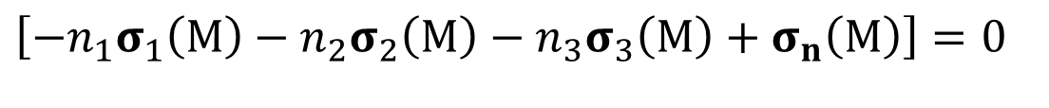
n = n_{i}e_{i} = const
const
0
h → 0
x→0
$$\left[−n_{1}σ_{1}\left(M\right)−n_{2}σ_{2}\left(M\right)−n_{3}σ_{3}\left(M\right)+σ_{n}\left(M\right)\right]=0$$

Slide 22
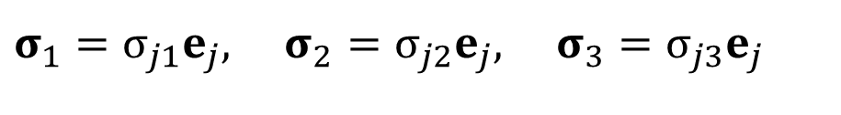
Equilibrium Equation of Surface Forces at the point
ΔP_{n} = σ_{n}ΔS
→
→
$$σ_{1}=σ_{j1}e_{j}, σ_{2}=σ_{j2}e_{j}, σ_{3}=σ_{j3}e_{j}$$
x₃
σ_{3n}
σ₃
e₃
→
n
σ_{n}
→
→
σ_{2n}
ΔS
σ₂
x₂
→
σ₁
e₂
→
e₁
σ_{1n}
x₁
→
→
→
New Cartesian coordinates with

Slide 23

→
→
→
→
→
→
→
→
$$e_{1}^{′}=α_{1i}e_{i} (n_{i}(e_{1}^{′})=α_{1i})$$
→
→
→
→
→
→
→
→
→
→
→
→
→
→
→
→
→
→
Theorem
The components σ_{ij} of the tractions constitute
a second-rank tensor
S = σ_{ij} e_{i}e_{j}.
→
→
Definition
The second-rank tensor
S = σ_{ij} e_{i}e_{j}.
whose components σ_{ij} are those of the tractions (stresses) is referred to as the stress tensor.
→
→

Slide 24
σ₃₃
x₃
e₃
- σ₁₁
A₃
S₋₁
σ₂₃
B₁
σ₁₃
B₂
S₃
- e₁
C
σ₃₂
- σ₂₁
σ₂
- e₂
- σ₁₂
σ₃₁
- σ₃₁
- σ₂₂
e₂
σ₂₂
σ₋₂
e₁
σ₁₂
σ₂₁
- σ₃₂
M
x₂
- σ₁₃
A₂
S₋₂
- σ₂₃
S₂
A₁
S₋₃
S₁
x₁
- e₃
B₃
σ₁₁
- σ₃₃
σ₁₁, σ₂₂, σ₃₃ - normal (compressive or tensile) stresses
σ₁₂, σ₁₃, σ₂₁, σ₂₃, σ₃₁, σ₃₂ - are tangential (shear) stresses

Slide 25
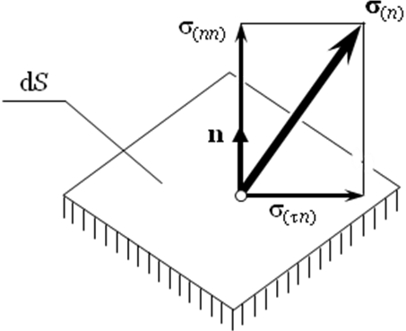
n
- Shear stress

Slide 26

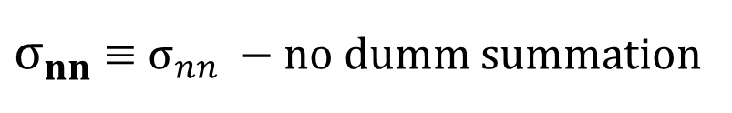


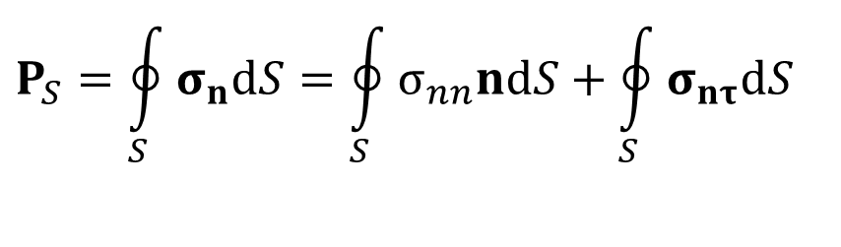





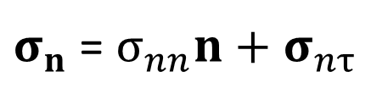
$$σ_{n}$$
→
$σ_{n}$ = $σ_{nn}n+σ_{nτ}$
→
→
→
$$σ_{n}$$
$$σ_{nn}$$
→
$$n$$
→
$$P_{S}=\oint_{S}{σ_{n}dS}=\oint_{S}{σ_{nn}ndS}+\oint_{S}{σ_{nτ}dS}$$
V
→
→
→
→
S
$σ_{nn}$ ≡ $σ_{nn} −no dumm summation$
$$σ_{n}$$
→
$$σ_{nn}$$
$$σ_{n}$$
→
$$n$$
→

Slide 27
σ₃₃
Balance of Linear Momentum
x₃
e₃
- σ₁₁
A₃
S₋₁
σ₂₃
B₁
σ₁₃
B₂
S₃
- e₁
C
σ₃₂
- σ₂₁
- e₂
- σ₁₂
σ₃₁
- σ₃₁
- σ₂₂
e₂
σ₂₂
e₁
σ₁₂
σ₂₁
- σ₃₂
M
x₂
- σ₁₃
A₂
S₋₂
- σ₂₃
S₂
A₁
S₋₃
S₁
x₁
- e₃
B₃
σ₁₁
- σ₃₃

Slide 28

x₃
−
S₋₁
- e₁
$${\tilde{M}}_{1}$$
M
S₋₂
S₂
x₂
S₁
h
x₁

Slide 30
σ₃ds −
σ₃ds =

Slide 32
M is an arbitrary point,

Slide 33
Balance of Angular Momentum

Slide 34
σ₃₃
x₃
Torsion arm
e₃
- σ₁₁
A₃
S₋₁
σ₂₃
B₁
σ₁₃
B₂
S₃
- e₁
C
σ₃₂
- σ₂₁
- e₂
- σ₁₂
σ₃₁
- σ₃₁
- σ₂₂
e₂
σ₂₂
e₁
σ₁₂
σ₂₁
- σ₃₂
M
x₂
- σ₁₃
A₂
S₋₂
- σ₂₃
S₂
A₁
S₋₃
S₁
x₁
- e₃
B₃
σ₁₁
- σ₃₃

Slide 35
σ₃₃
x₃
e₃
- σ₁₁
A₃
S₋₁
σ₂₃
B₁
σ₁₃
B₂
S₃
- e₁
C
σ₃₂
- σ₂₁
- e₂
- σ₁₂
σ₃₁
- σ₃₁
- σ₂₂
e₂
σ₂₂
e₁
σ₁₂
σ₂₁
- σ₃₂
M
x₂
- σ₁₃
A₂
S₋₂
- σ₂₃
S₂
A₁
S₋₃
S₁
x₁
- e₃
B₃
σ₁₁
- σ₃₃

Slide 36
σ₃₃
x₃
e₃
- σ₁₁
A₃
S₋₁
σ₂₃
B₁
σ₁₃
B₂
S₃
- e₁
C
σ₃₂
- σ₂₁
- e₂
- σ₁₂
σ₃₁
- σ₃₁
- σ₂₂
e₂
σ₂₂
e₁
σ₁₂
σ₂₁
- σ₃₂
M
x₂
- σ₁₃
A₂
S₋₂
- σ₂₃
S₂
A₁
S₋₃
S₁
x₁
- e₃
B₃
σ₁₁
- σ₃₃

Slide 37
M is an arbitrary point,

Slide 38
Note:
Stress tensor symmetry follows from the moment balance written, which contains contributions from body forces and contact stresses only.
Note:
In certain structured continua known as micropolar media, angular momentum contains a contribution from intrinsic spin proportional to the control volume or h³.
An additional contribution can arise from distributed surface couples.
These effects can break the symmetry of the stress and should be analyzed separately.

Slide 39
M
(b)
Theorem 1. For the stress tensor at arbitrary point M, there exist three mutually orthogonal principal planes (with normal vectors along the principal directions of stress) on which stresses are strictly normal
Convention on order of numbers:

Slide 40
Definitions.
A state of stress in which none of the three principal stresses vanishes ( ≠ 0, i = 1, 2, 3) is said to be triaxial:
When one—and only one—principal stress vanishes, the state of stress is referred to as plane or biaxial:
When two principal stresses vanish, the state of stress is called uniaxial:

Slide 41






σ_{n}
σ_{nn}
Arbitrary plane with unit normal
$$_{3}^{∗}$$
→
δS
n
σ_{nτ}
$$_{1}^{∗}$$
M
→
$$e_{2}^{∗}$$
$$_{2}^{∗}$$
→
$$σ_{nn}=σ_{n}⋅n=\left(σ_{1}^{∗}n_{1}^{∗}e_{1}^{∗}+σ_{2}^{∗}n_{2}^{∗}e_{2}^{∗}+σ_{3}^{∗}n_{3}^{∗}e_{3}^{∗}\right)⋅\left(n_{1}^{∗}e_{1}^{∗}+n_{2}^{∗}e_{2}^{∗}+n_{3}^{∗} e_{3}^{∗}\right)=$$
∗
σ_{ij} = – pδ_{ij} + τ_{ij} , p = – (σ₁₁ + σ₂₂ + σ₃₃) = – σ_{kk} - invariant pressure
$$1/3$$
$$1/3$$

Slide 42
σ_{nn} and σ_{nτ} are even functions of
.
S₃
T₂₃
S₂
T₁₃
T₁₂
S₁

Slide 43
S₃
P₂₃
S₂
S₂
P₃₂
S₃
S₁
P₂₁
S₃
P₁₃
P₁₂
P₁₂
T₁₂
T₁₃
T₂₃
S₁
S₁
S₂
Extremum values of normal and shear stresses
Principal Directions

Slide 44





Principal shear directions, and principal shear stresses.
Maximum shear stresses $σ_{nτ}$
$${\text{T}}_{23}$$
$${\text{T}}_{13}$$
$${\text{T}}_{12}$$
$$e_{1}^{∗}$$

Slide 45



Mohr diagram
σ_{τn}
T₁₃
T₁₂
T₂₃
S₂
S₃
S₁
σ_{nn}
$$σ_{3}^{∗}$$
C₂₃
$$σ_{2}^{∗}$$
C₁₃
C₁₂
$$σ_{1}^{∗}$$

Slide 46

Material Time Derivatives of the Stress Tensor
For function ϕ(x, t):
dϕ = (∇_{i}ϕ) dx_{i} + dt = ϕ(x + dx, t + dt) – ϕ(x, t) + o(dx, dt).
dx = v dt, dx_{i} = v_{i}dt
$$\frac{dφ}{dt}=\frac{∂φ}{∂t}+{\text{v}}_{1}\frac{∂φ}{∂x_{1}}+{\text{v}}_{2}\frac{∂φ}{∂x_{2}}+{\text{v}}_{3}\frac{∂φ}{∂x_{3}}= \\ \frac{∂φ}{∂t}+{\text{v}}_{i}\frac{∂φ}{∂x_{i}}=\frac{∂φ}{∂t}+{\text{v}}_{i}\left(∇_{i}φ\right)=\frac{∂φ}{∂t}+\left(v⋅\vec{∇}\right)φ=$$
v

Slide 47
$$σn = σn\left(n, x, t\right)$$
n
→
Δx = v Δt, Δn = [ω×n ] Δt,
Δx_{i} = v_{i} Δt,
Δn_{i} = ε_{ijk}ω_{j}n_{k} Δt = ε_{ijk} ω_{j}n_{k} Δt
n
→
→
→
ω
Δx

Slide 48


$$\begin{matrix}k i j \\ \\ l m j\end{matrix}$$
$$\begin{matrix}k i j \\ \\ l m j\end{matrix}$$
Δx = v Δt, Δn = [ω×n ] Δ t,
Δx_{i} = v_{i} Δt
ε_{ijk}ε_{lmk} ≡ ε_{kij}ε_{klm} = δ_{il} δ_{jm} – δ_{im}δ_{jl}
Δn_{i} = ε_{ijk}ω_{j}n_{k} Δt = ε_{ijk} ω_{j}n_{k} Δt = ε_{ijk} (¹/₂ rot v)_{j} n_{k} Δt = ¹/₂ Δt n_{k} ε_{ijk} ε_{jlm}∇_{l} v_{m}
= ¹/₂ Δt n_{k} ε_{jki} ε_{jlm}∇_{l} v_{m} = ¹/₂ Δt n_{k} (δ_{kl} δ_{im} − δ_{km} δ_{il} )∇_{l} v_{m} =
= ¹/₂ Δt n_{k} (δ_{kl} δ_{im}∇_{l} v_{m} − δ_{km} δ_{il} ∇_{l} v_{m} ) = Δt n_{k} (∇_{k} v_{i} − ∇_{i}v_{k} ) ¹/₂ =
= Δt n_{k} ω_{ik}

Slide 50
dx = v dt (dx_{i} = v_{i} dt)
dn = [ω×n ] dt (dn_{i} = dt n_{k} ω_{ik})
dμ = [ω×μ ] dt (dμ_{i} = dt μ_{k} ω_{ik})
dn_{i} = ε_{ijk}ω_{j}n_{k} dt = n_{k} ω_{ik} dt
dμ_{i} = ε_{ijk}ω_{j}μ_{k} dt = μ_{k} ω_{ik}dt
n and μ move and rotate as rigid body (v and ω)

Slide 51

Let
Then
v
- Yaumann Derivative
$\frac{d_{(v)}σ_{ij}}{dt}={\left(\frac{∂σ_{ij}}{∂t}\right)}_{x, n}$+ ${\left(\frac{∂σ_{ij}}{∂x_{i}}\right)}_{t, n}{\text{v}}_{i}$

Slide 52


$$\text{or} \frac{dρ}{ dt}+ρ∇_{i}{\text{v} }_{i}=0$$
MOMENTUN CONSERVATION EQUATION
$$\left(∇_{i}≡\frac{∂}{∂x_{i}}, \frac{d}{dt}≡\frac{∂}{∂t}+{\text{v}}_{i}\frac{∂}{∂x_{i}}\right)$$

